Slide 1

Introduction to Object Oriented Programming

Slide 2
Introduction
Object Oriented Programming (OOP) is one of the most widely used programming paradigm( A style of programming). It is based on the concept of Objects.
Object Oriented Programming was developed because limitations were discovered in earlier approaches to programming.

Slide 3
Why it is extensively used?
Well suited for building simple and complex applications
Allows re-use of code so that increasing productivity
New features can be easily built into the existing code
Reduced production cost and maintenance cost

Slide 4
Object Oriented
Programming Concepts
Building Blocks
Class / Classes
Object / Objects
Abstraction
Encapsulation
Inheritance
Polymorphism

Slide 5
Object
Objects are the basic building blocks for designing programs.
An object is a collection of data members and associated member functions.
Each object identified by a unique name.
Each object must me member of a particular class
Example:- apple, mango, orange are objects of class Fruit.

Slide 6
Class
Prototype or blueprint from which objects are created.
A class is a collection of objects that have identical properties, common behavior and shared relationship.
Once class is defined, we can create any no of objects of that class.
Classes are user defined data types.
A class can hold both data and methods.

Slide 7
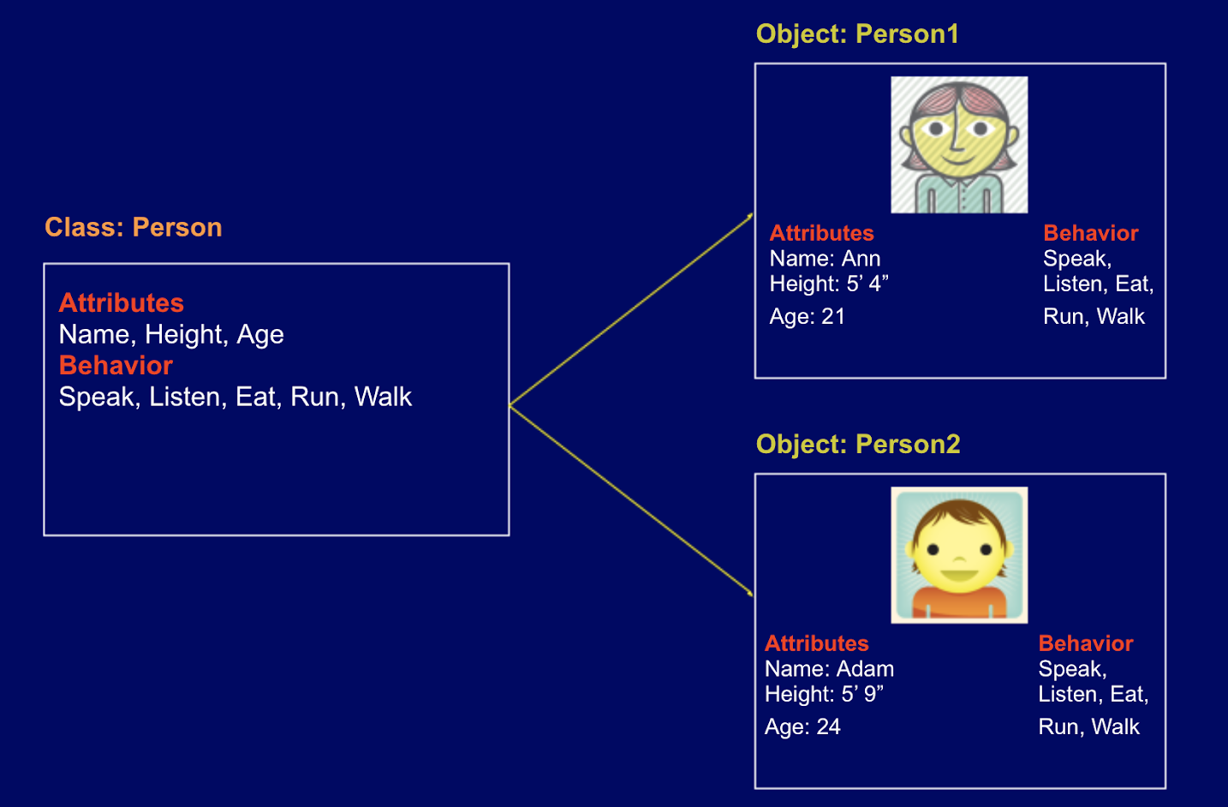
Example

Slide 8
Abstraction
Abstraction refers to the quality of dealing with ideas rather than events. It basically deals with hiding the details and showing the essential things to the user.
Abstraction helps to reduce complexity.
In java we can implement it by using the abstract class and interface

Slide 9
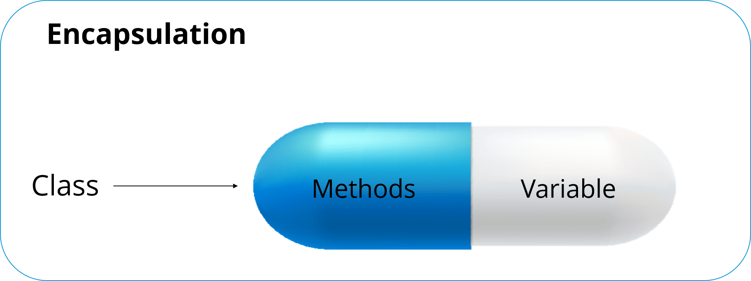
Encapsulation
Encapsulation is a mechanism where you bind your data and code together as a single unit.
Encapsulation = Data Hiding + Abstraction

Slide 10
Inheritance
Inheritance is the concept where the properties of one class can be inherited by the other. It helps to reuse the code and establish a relationship between different classes.
Inheritance represent the Is a relationship. By using extends keyword we can implement is a relationship in java.
Important terminology:
Super Class: The class whose features are inherited is known as super class(or a base class or a parent class).
Sub Class: The class that inherits the other class is known as subclass (or a derived class, extended class, or child class). The subclass can add its own fields and methods in addition to the superclass fields and methods.

Slide 11
Polymorphism
Polymorphism means taking many forms, where ‘poly’ means many and ‘morph’ means forms
polymorphism allows you define one interface or method and have multiple implementations.
In Java, it is of two types:
Static Polymorphism (Method Overloading)
Dynamic Polymorphism (Method Overriding)

Slide 12
Thank You

